Slide 1
GENETIC ALGORITHMS
Course Code: CSC4226
Course Title: Artificial Intelligence and Expert System
Dept. of Computer Science
Faculty of Science and Technology
Lecture No: | Five (5) | Week No: | Five (5) | Semester:
Lecturer: | SAZIA SHARMIN

Slide 2
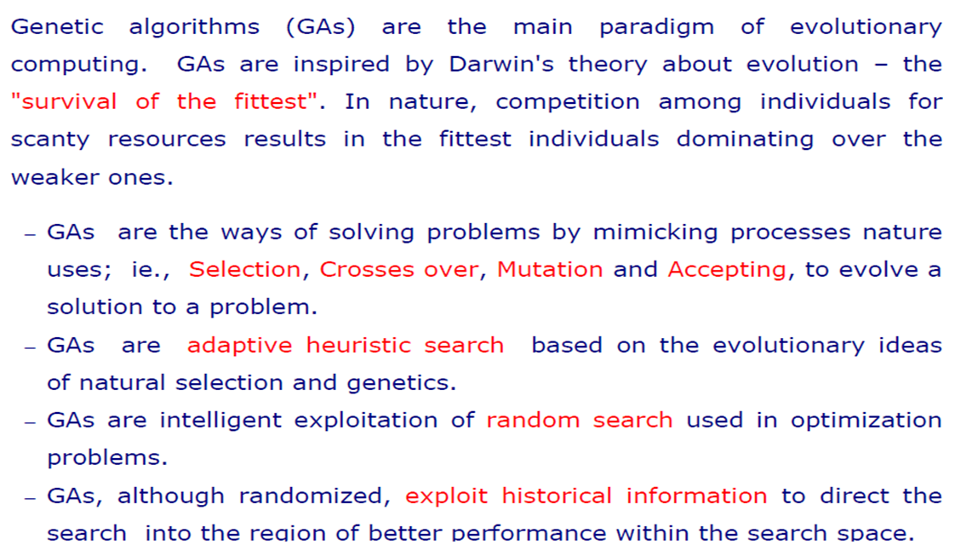
GA: BASIC CONCEPT

Slide 3
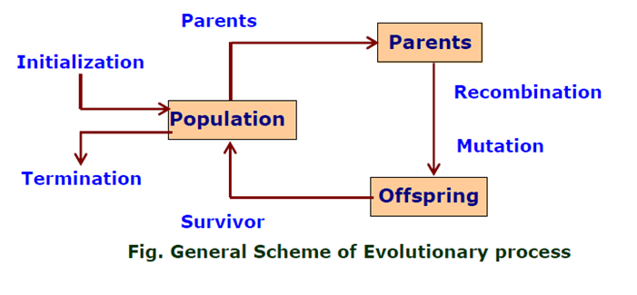
GA: FLOW-CHART

Slide 4
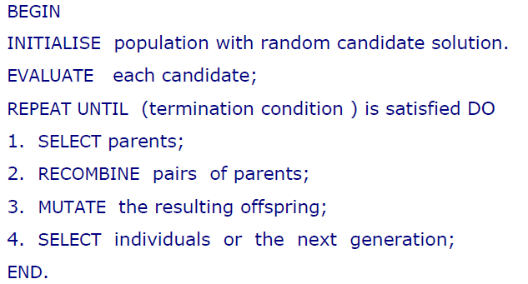
GA: PSEUDO-CODE

Slide 5
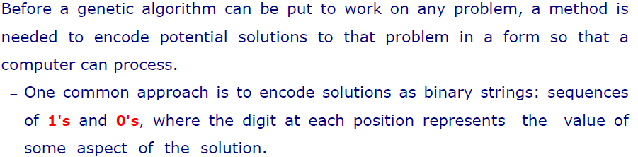
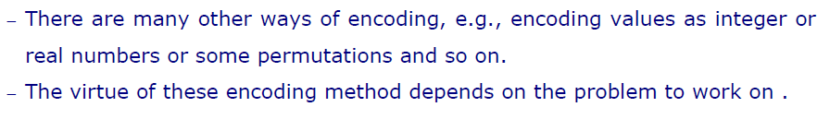
ENCODING

Slide 6
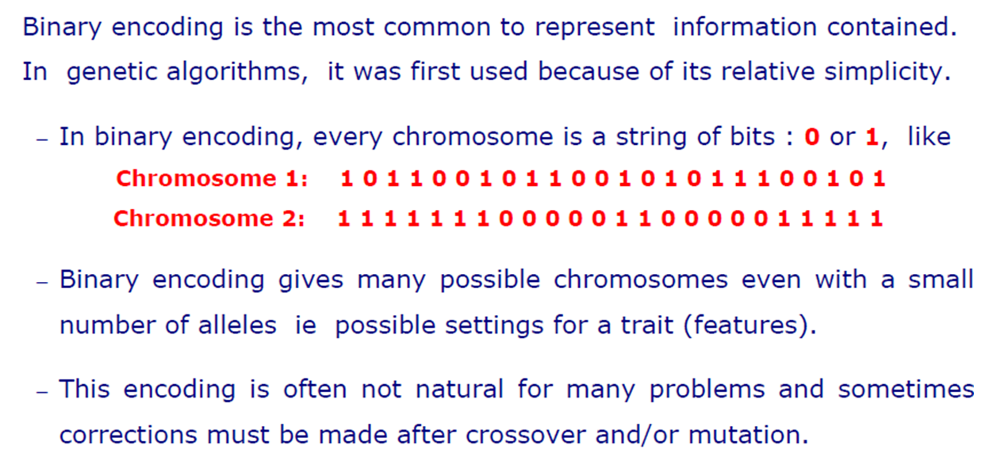
BINARY ENCODING

Slide 7
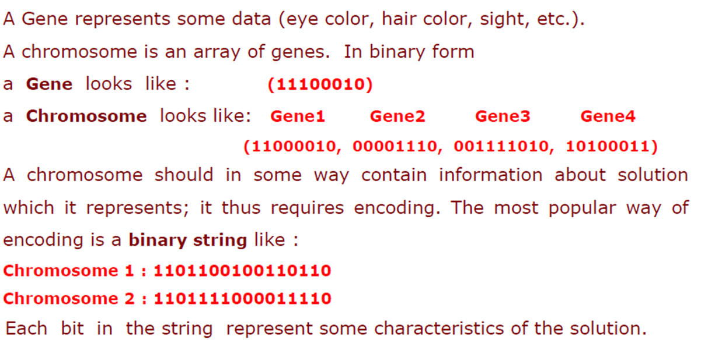
Example: Binary Encoding

Slide 8
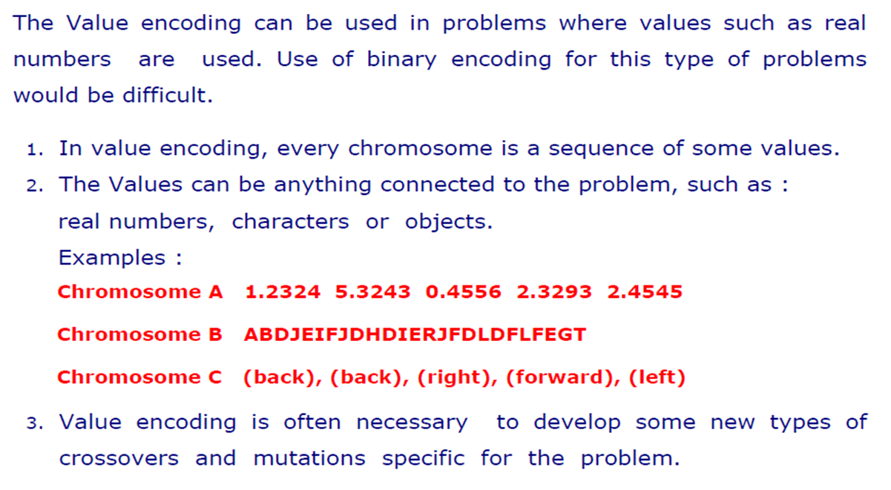
Value Encoding

Slide 9
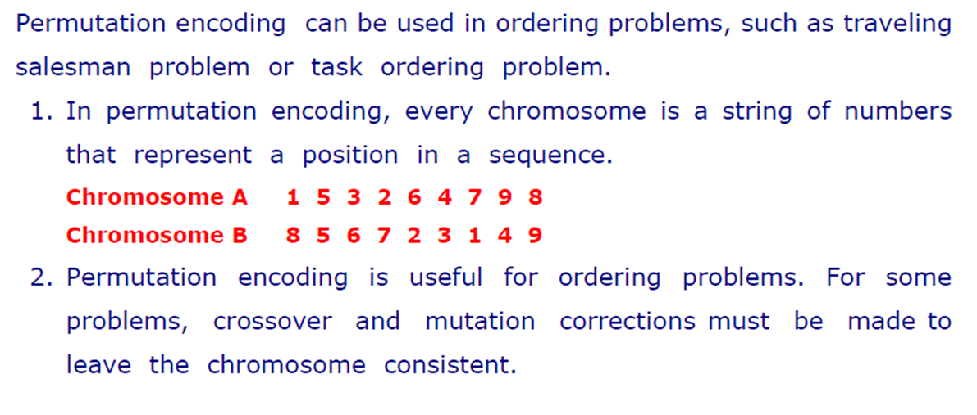
Permutation Encoding

Slide 10
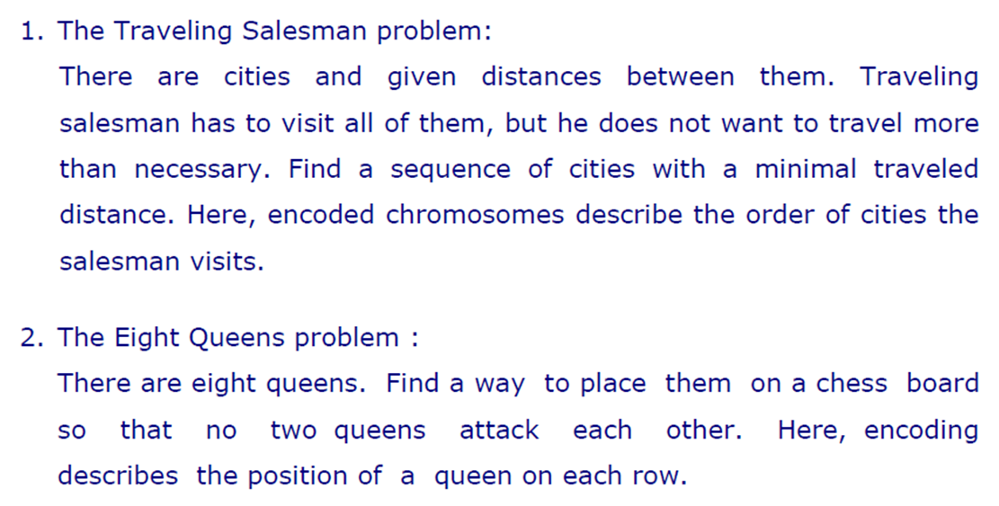
Examples: Permutation Encoding

Slide 11
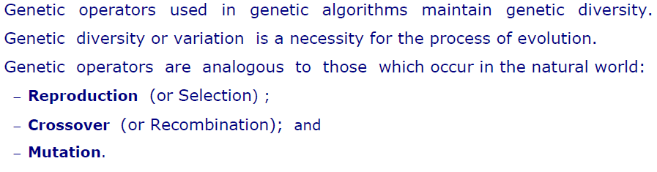
Operators of GA

Slide 12
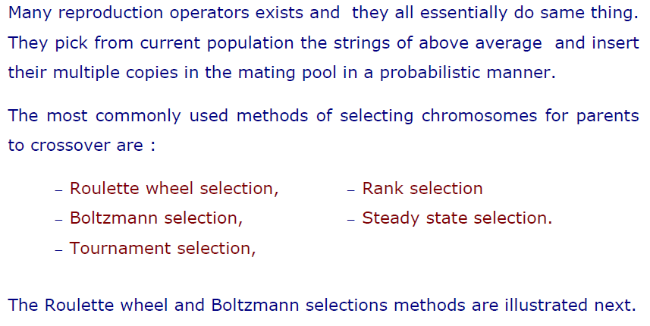
Selection

Slide 13
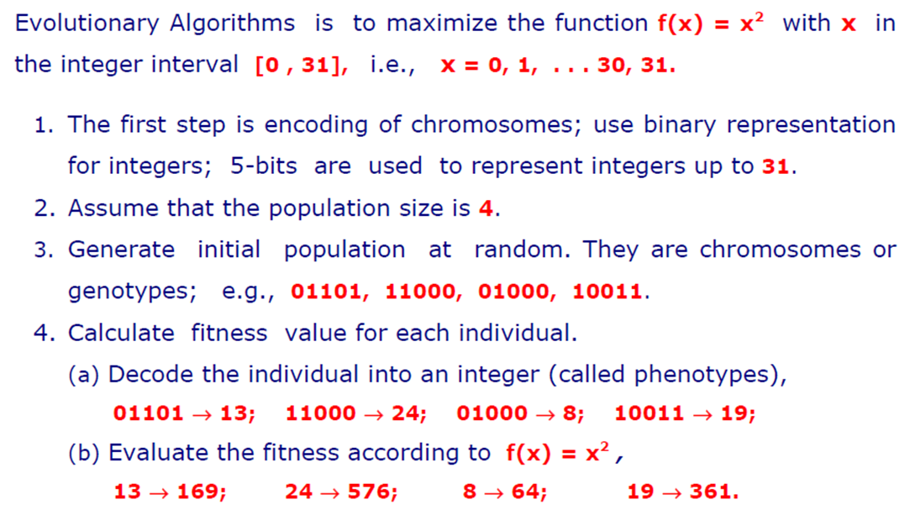
Example of Selection

Slide 14
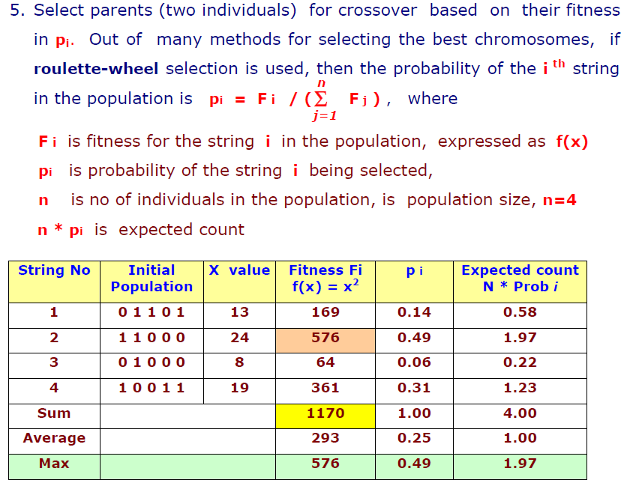
Example of Selection

Slide 15
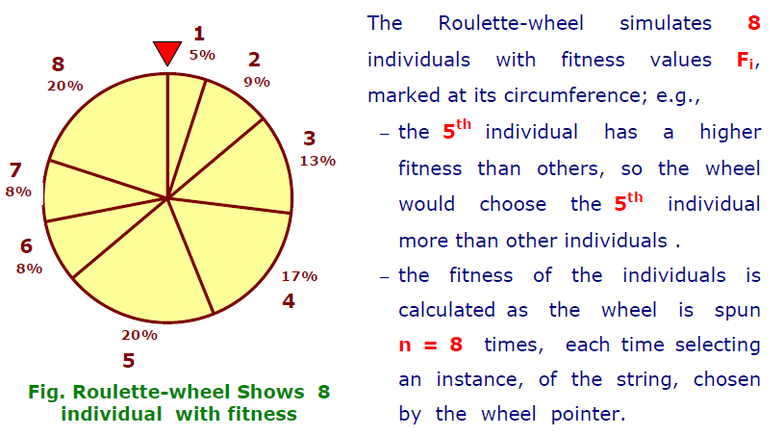
Roulette Wheel Selection

Slide 16
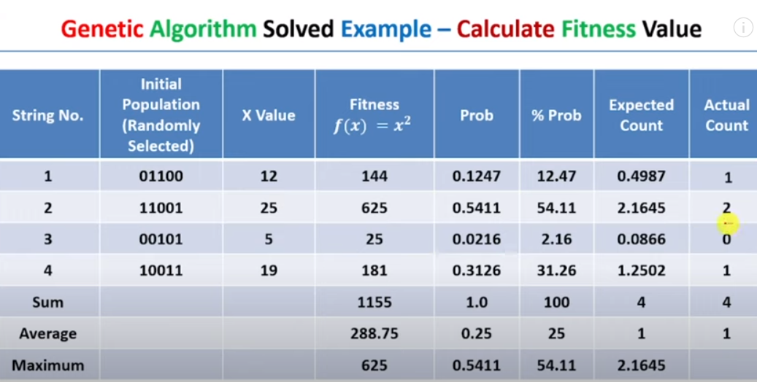
Calculate fitness value

Slide 17
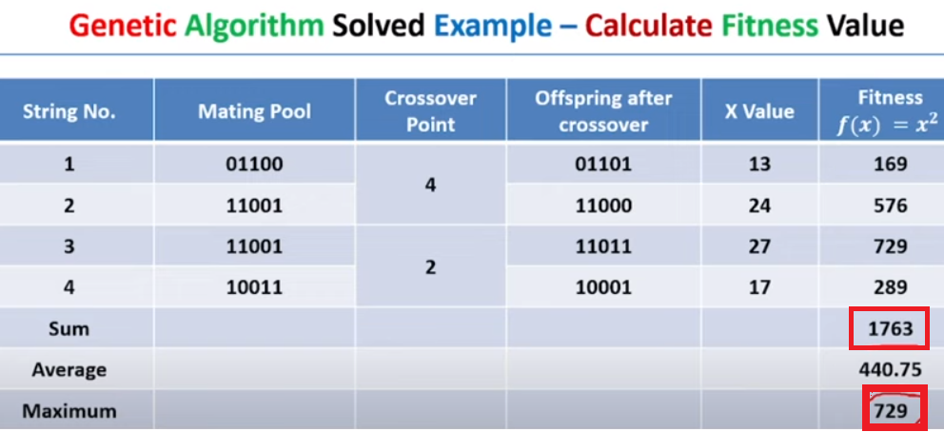
Calculate fitness value

Slide 18
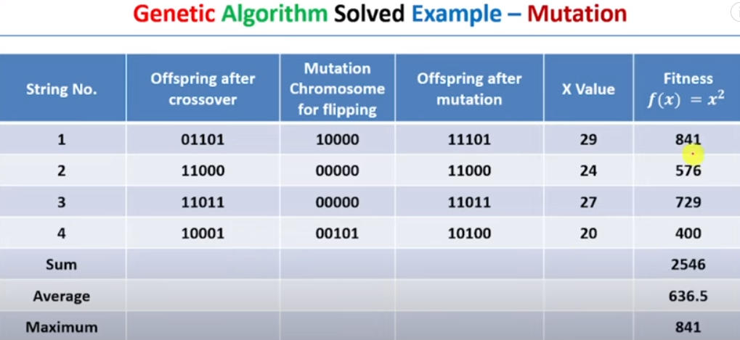
Mutation

Slide 19
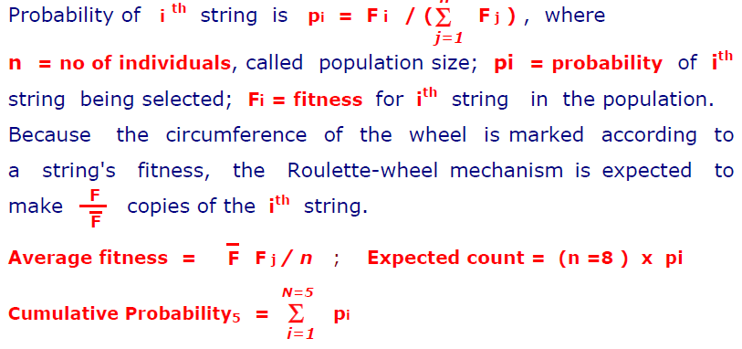
Roulette Wheel Selection

Slide 20
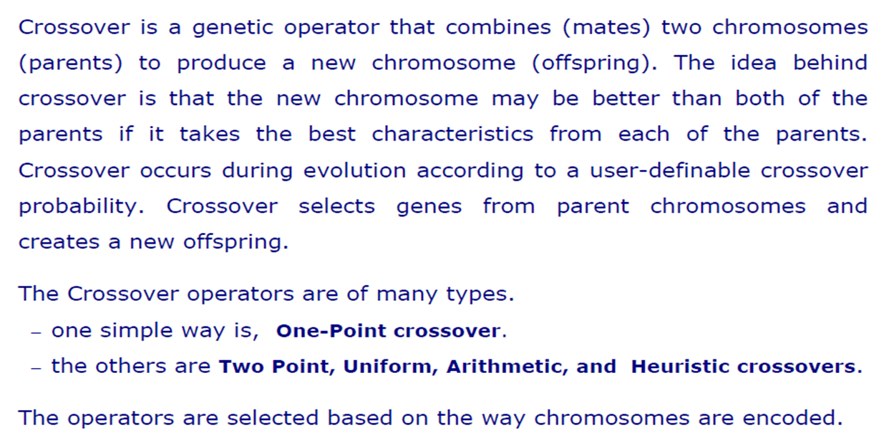
Crossover

Slide 21
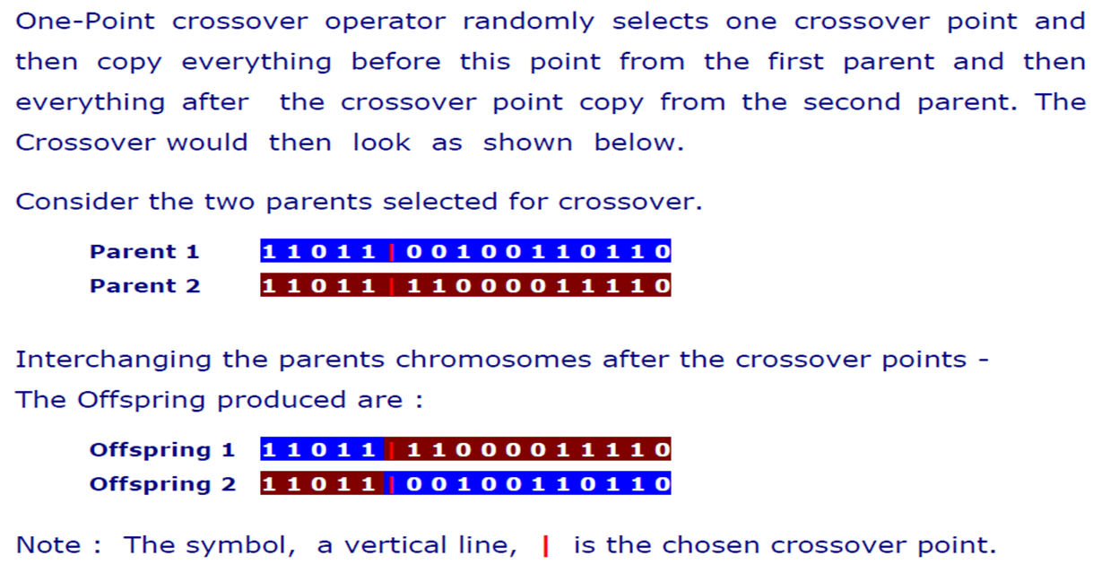
One-Point Crossover

Slide 22
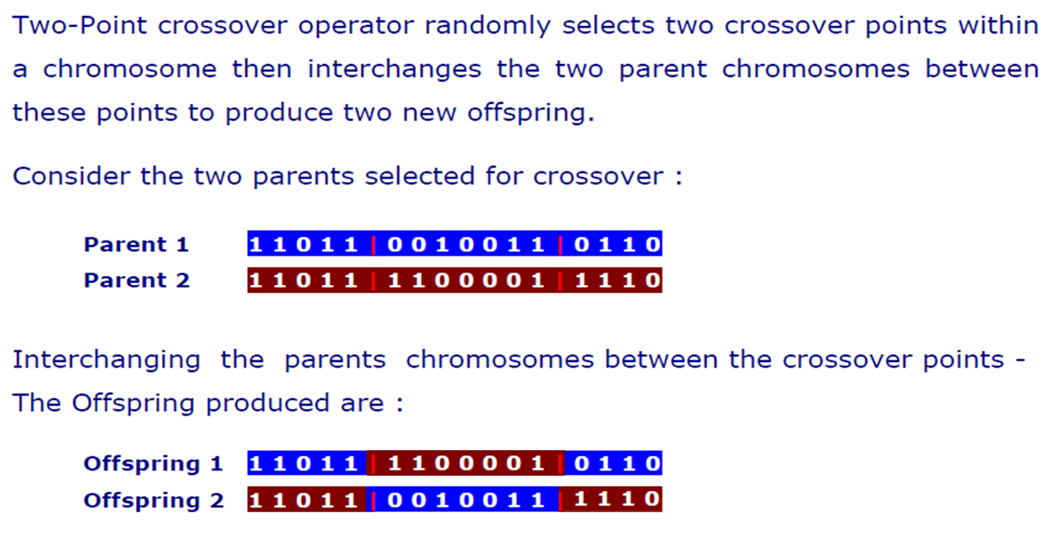
Two-Point Crossover

Slide 23
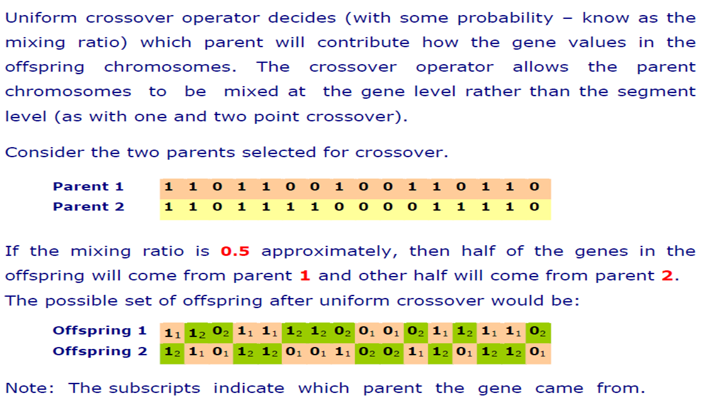
Uniform Crossover

Slide 24
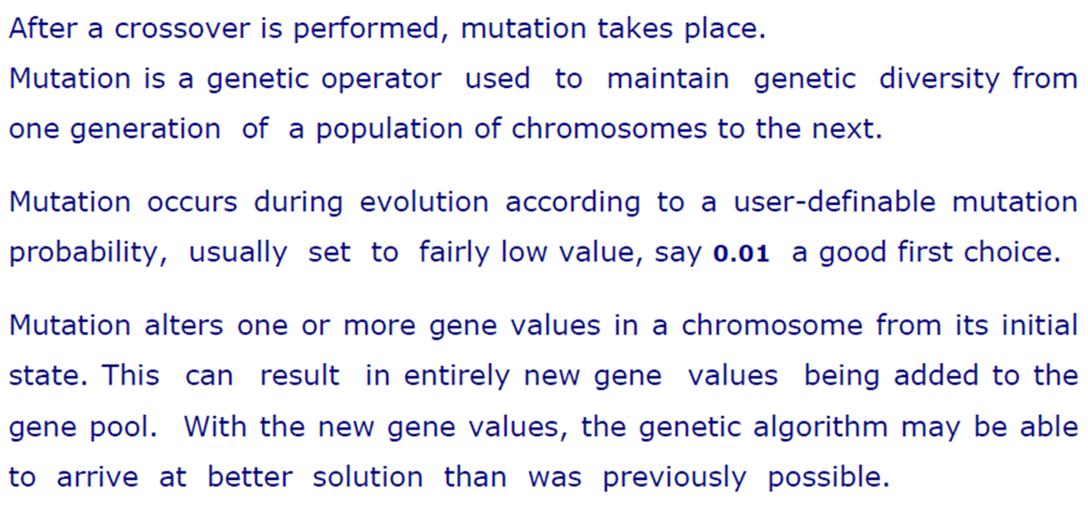
Mutation

Slide 25
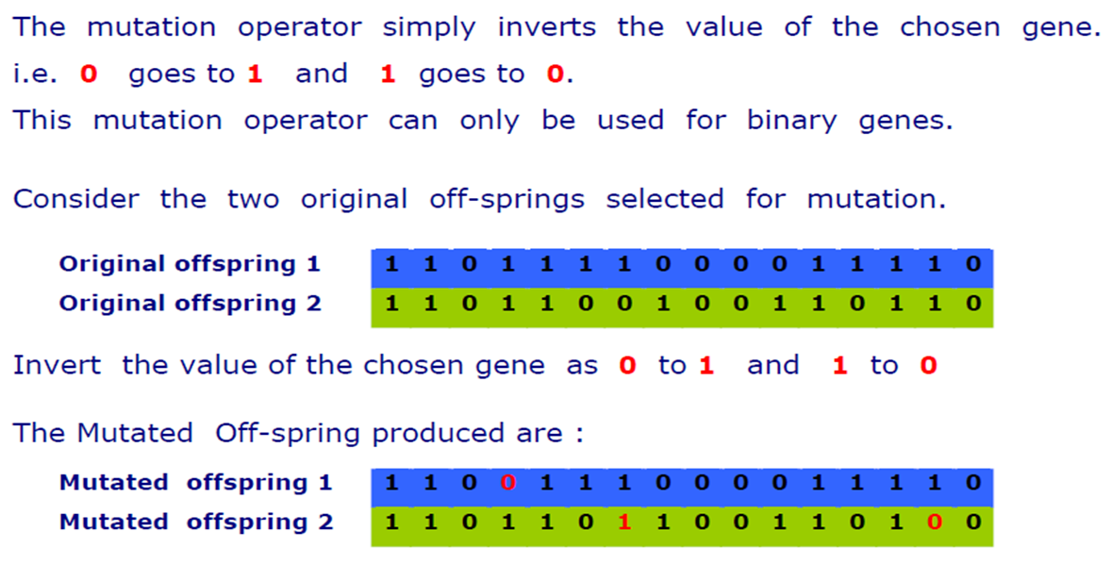
Flip Bit Mutation

Slide 26
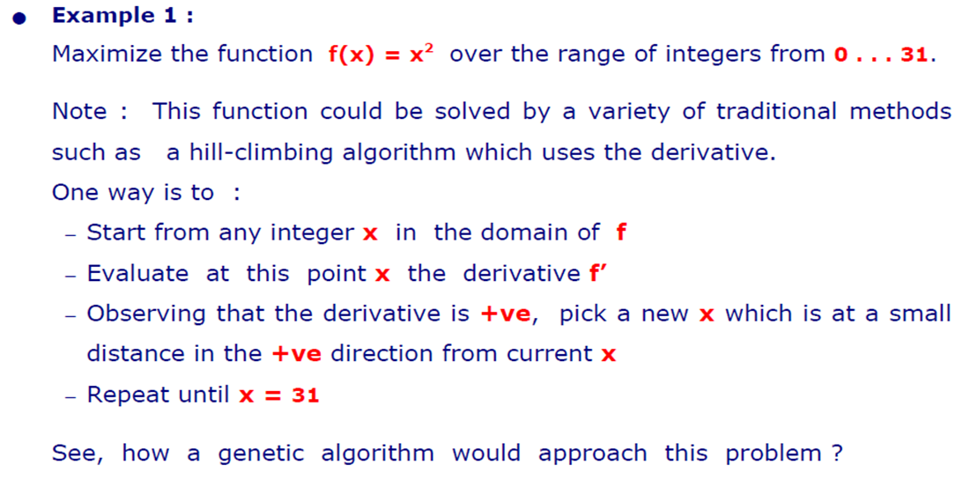
Demonstration

Slide 27
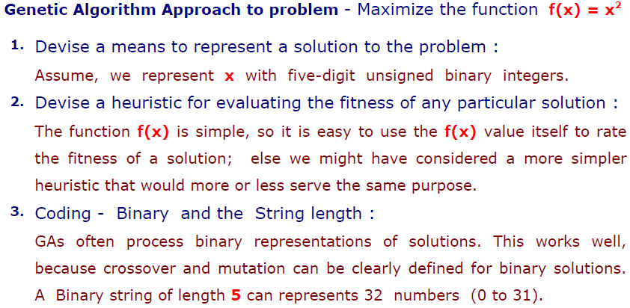
GA Approach

Slide 28
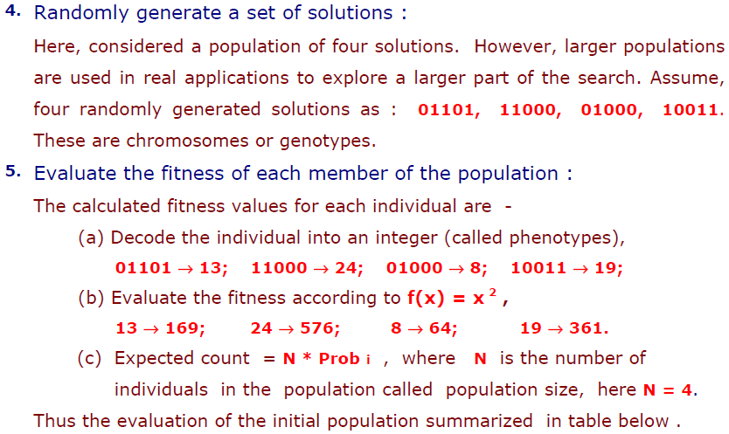
GA Approach

Slide 29
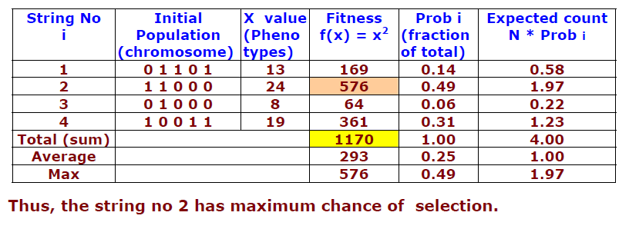
Calculating Fitness & Probability

Slide 30
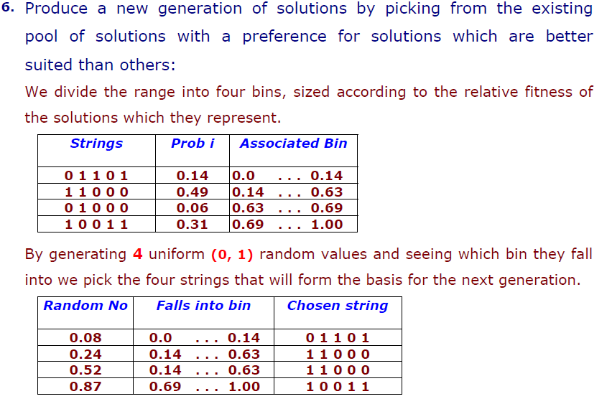
Selection

Slide 31
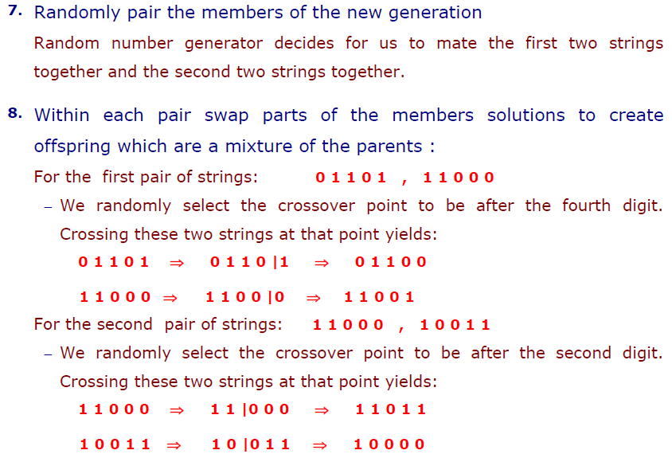
Crossover

Slide 32
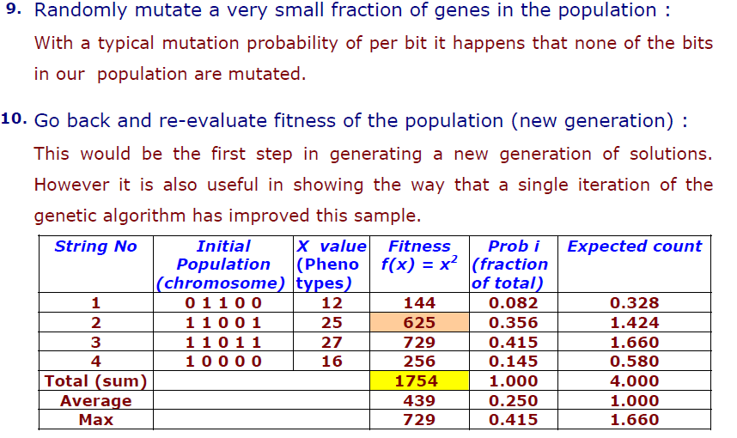
Mutate & Re-evaluate

Slide 33
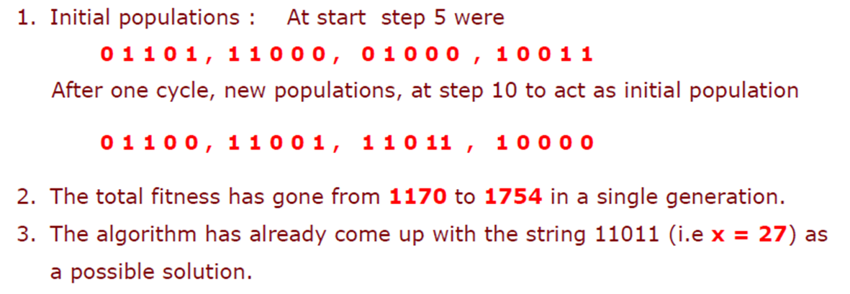
Improved: Individual & Total Fitness

Slide 34
Books
“Artificial Intelligence: A Modern Approach,” by Stuart J. Russell and Peter Norvig.
"Artificial Intelligence: Structures and Strategies for Complex Problem Solving", by George F. Luger, (2002)
"Artificial Intelligence: Theory and Practice", by Thomas Dean.
"AI: A New Synthesis", by Nils J. Nilsson.
“Programming for machine learning,” by J. Ross Quinlan,
“Neural Computing Theory and Practice,” by Philip D. Wasserman, .
“Neural Network Design,” by Martin T. Hagan, Howard B. Demuth, Mark H. Beale, .
“Practical Genetic Algorithms,” by Randy L. Haupt and Sue Ellen Haupt.
“Genetic Algorithms in Search, optimization and Machine learning,” by David E. Goldberg.
"Computational Intelligence: A Logical Approach", by David Poole, Alan Mackworth, and Randy Goebel.
“Introduction to Turbo Prolog”, by Carl Townsend.

